Slide 1
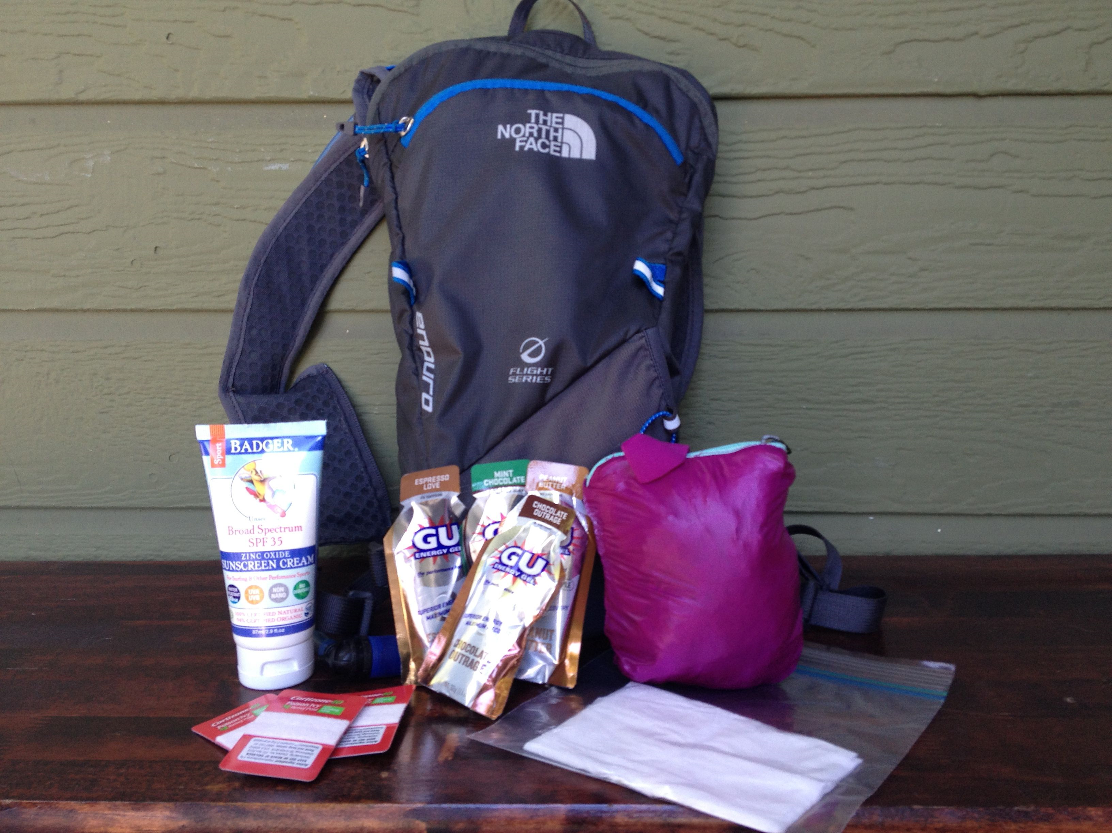
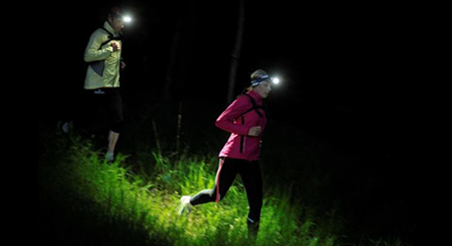
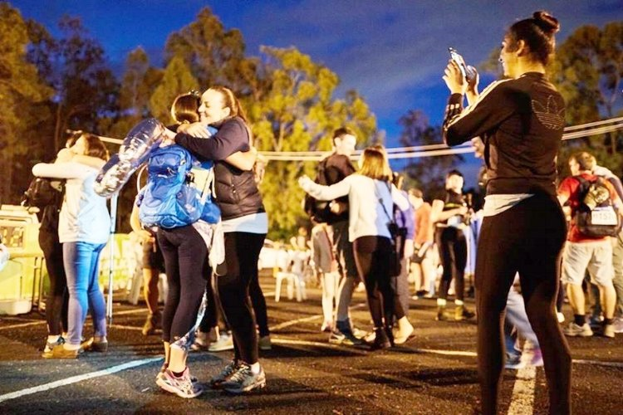
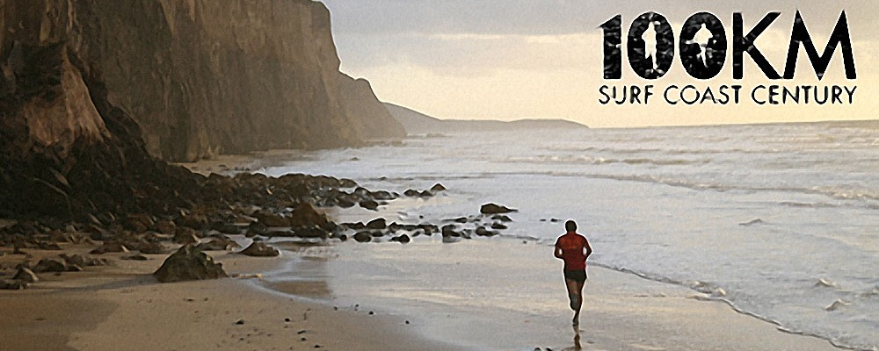
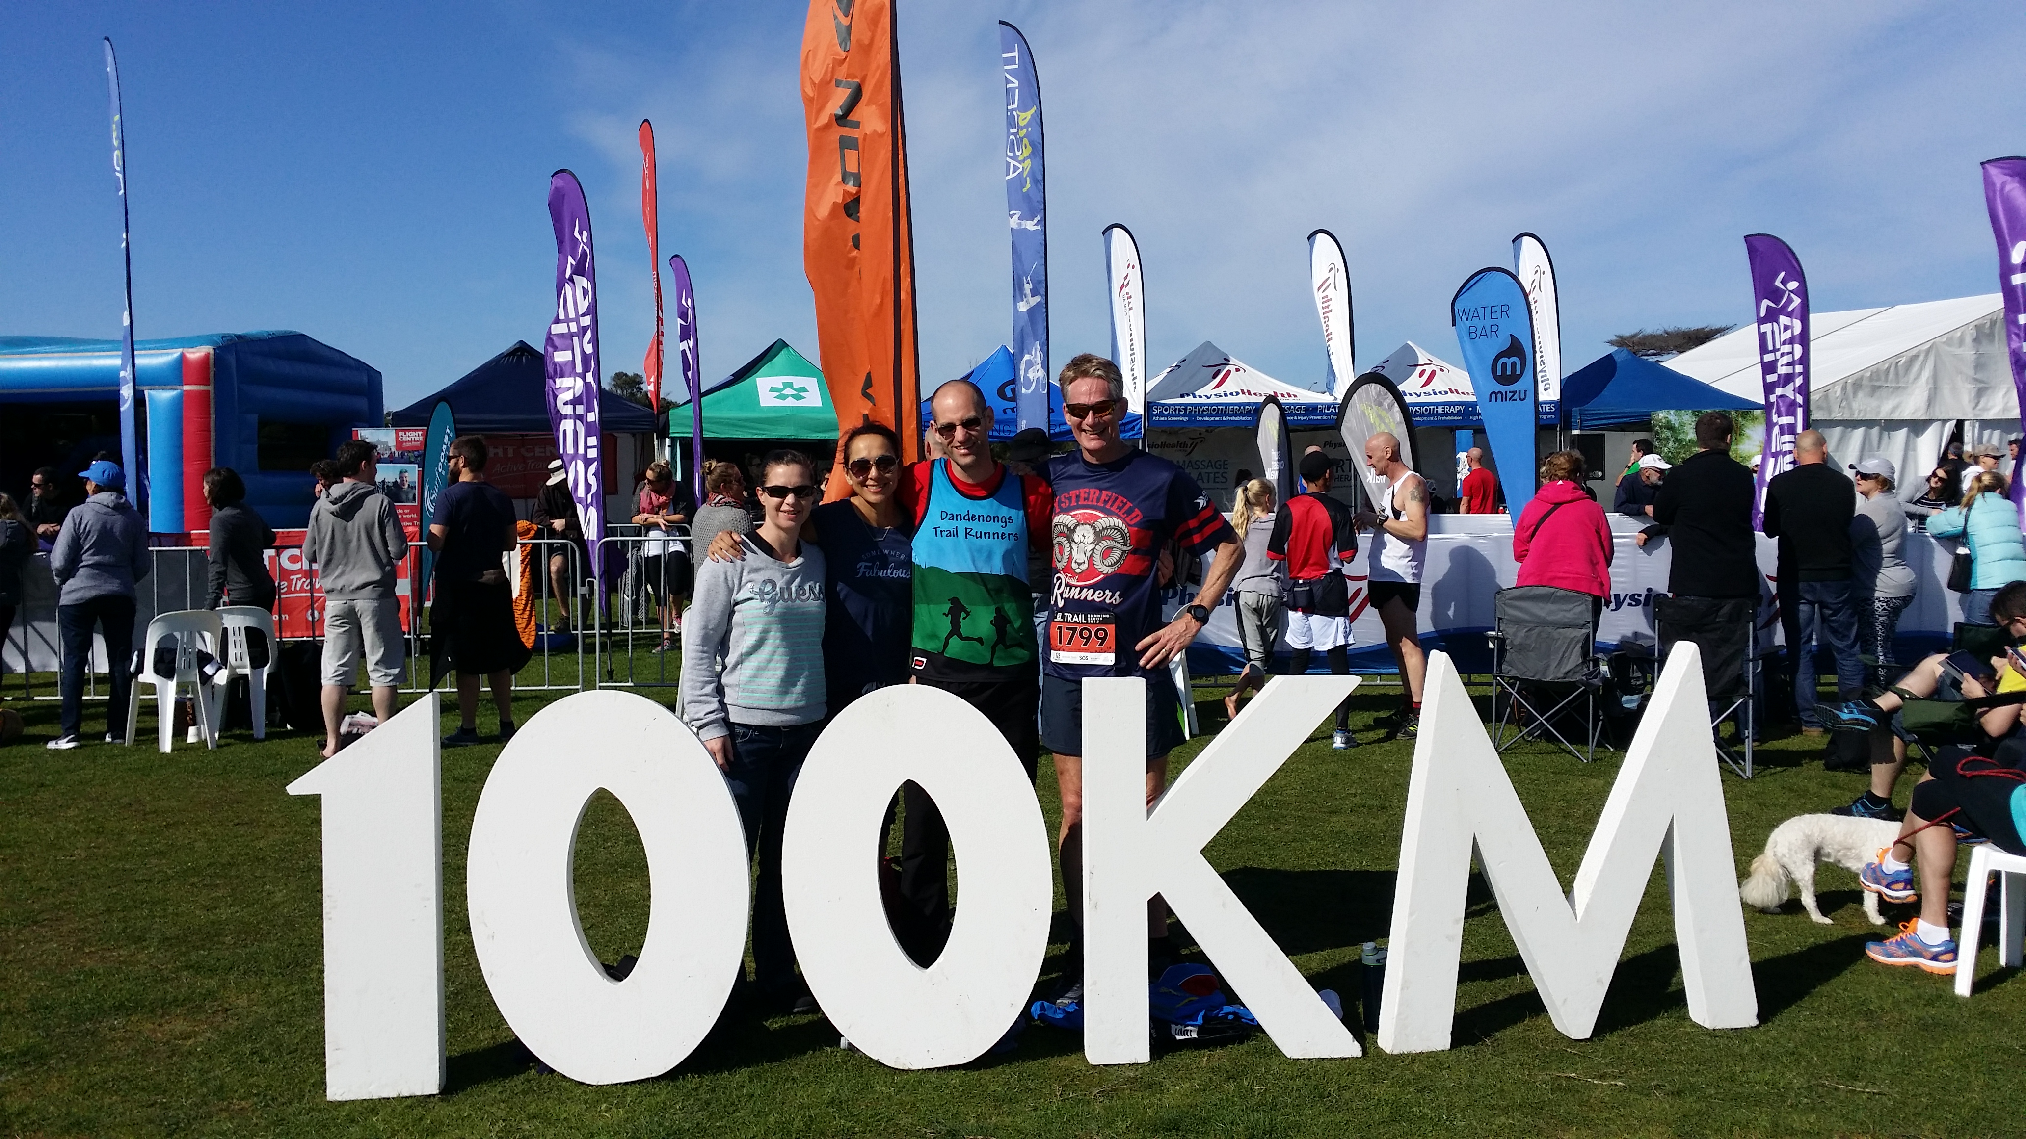
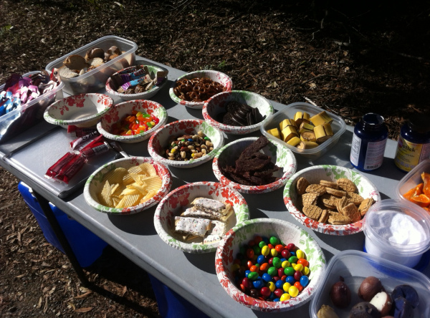
Pacing predictor
One mile at a time…my race, my pace

Slide 2
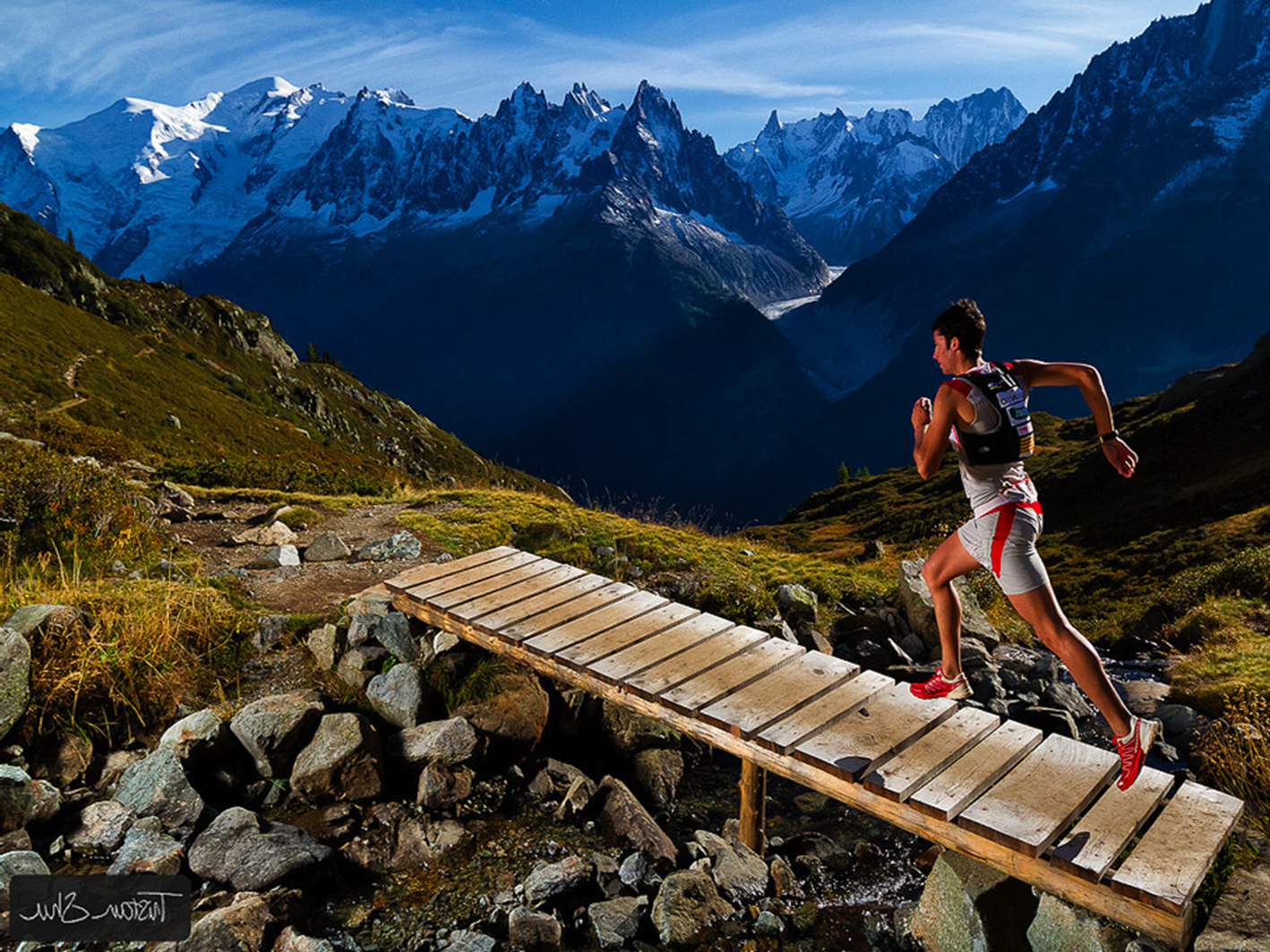
RECAP…
First 100km race in 4 weeks
Twice the distance I have ever ran before
Current guess is a 11-13 hour finishing time.
Can I be more precise?

Slide 3
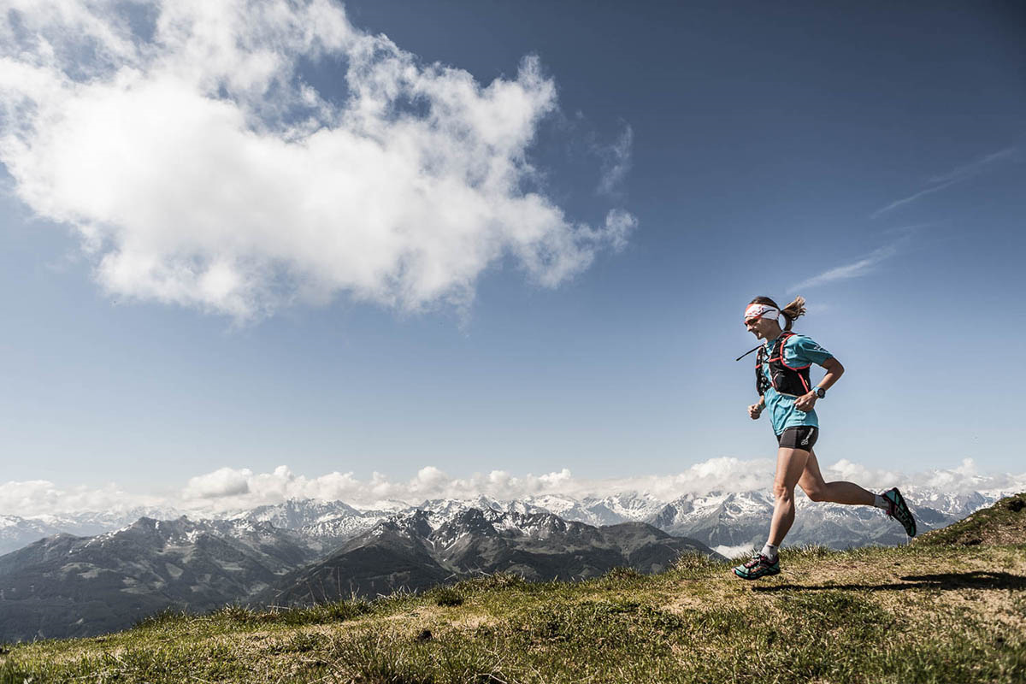
Pacing in Ultra-marathons is critical…
2
3
I know what nutrition to carry per hour, but how many hours will it take me to get to each checkpoint?
My family know where I will be @50km, but they also want to know when?
4
Where will I be when the sun sets? Will I need a headlamp?
Distance:
21km 29km
Elevation 366m
Gain: 97m
0 km
21 km
50 km
77 km
100 km
Going too fast here…
How do I know how to pace if I have only ever tried running this far?
Will lead to stopping here…
1

Slide 4
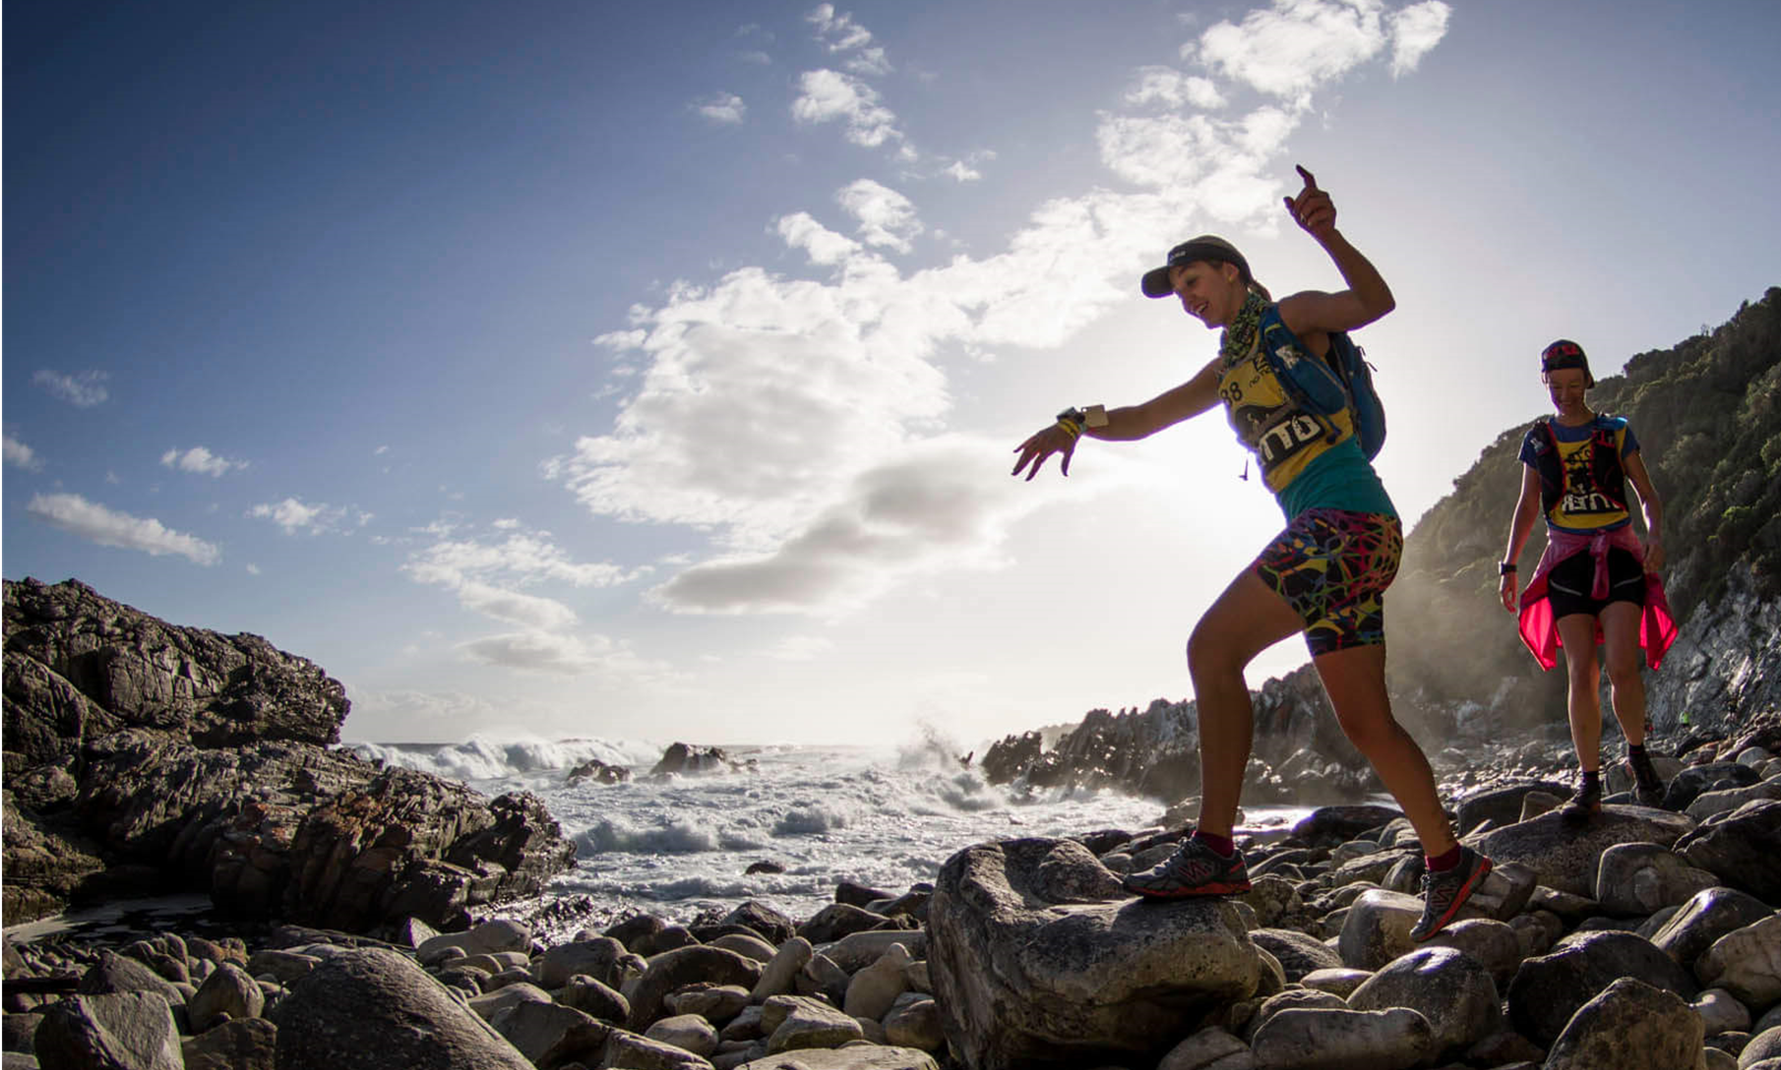
Objectives…
Predict my pace per segment for the Race
Use this to calculate:
Best pacing to suit my level of fitness
Nutrition needs for each segment
Time of arrival at a checkpoint for family and friends
When/If I will need a headlamp
Pace = f(effort, terrain, fitness)

Slide 5
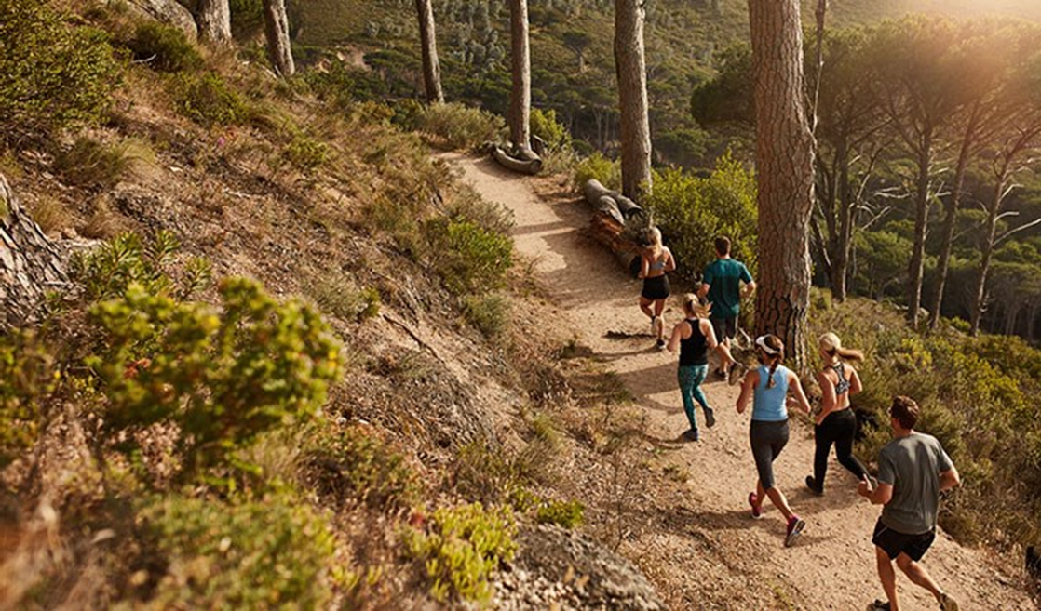
Two Approaches to predicting pace…
Pace = f(effort, terrain, fitness)
Approach 1: Predict Pace
Estimate my effort when running 100km
Understand how my pace varies over different terrain
Adjust for expected fitness level going into the race
Approach 2: Predict Place
Predict what place I will finish based on my past races
Use past SCC results to determine what pace past participants in that position completed the race in

Slide 6
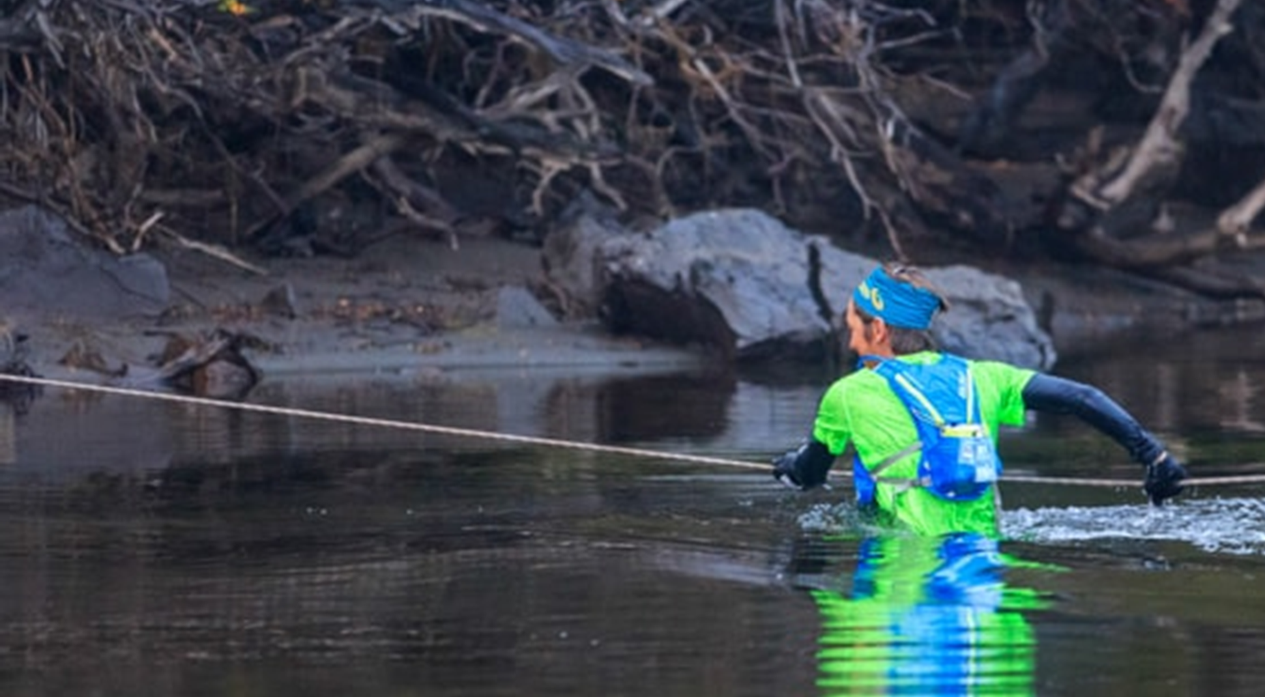
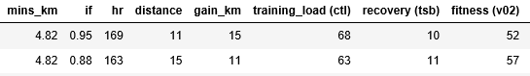
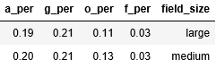
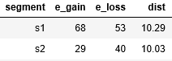
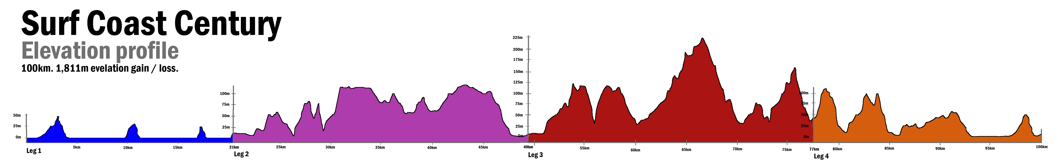
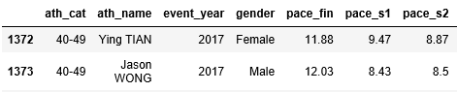
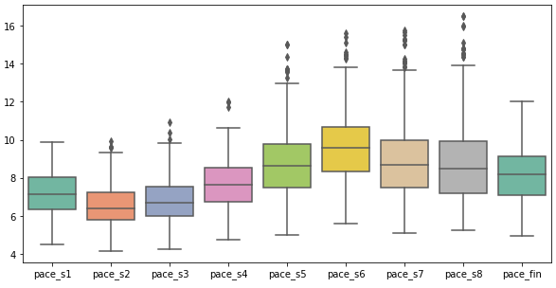
3 key sources of Data…
My Own Race Data
SCC Course Distance and elevation
Past SCC Results from 2015-2017
Y metric
Effort
Terrain
Fitness
Race Placing

Slide 7
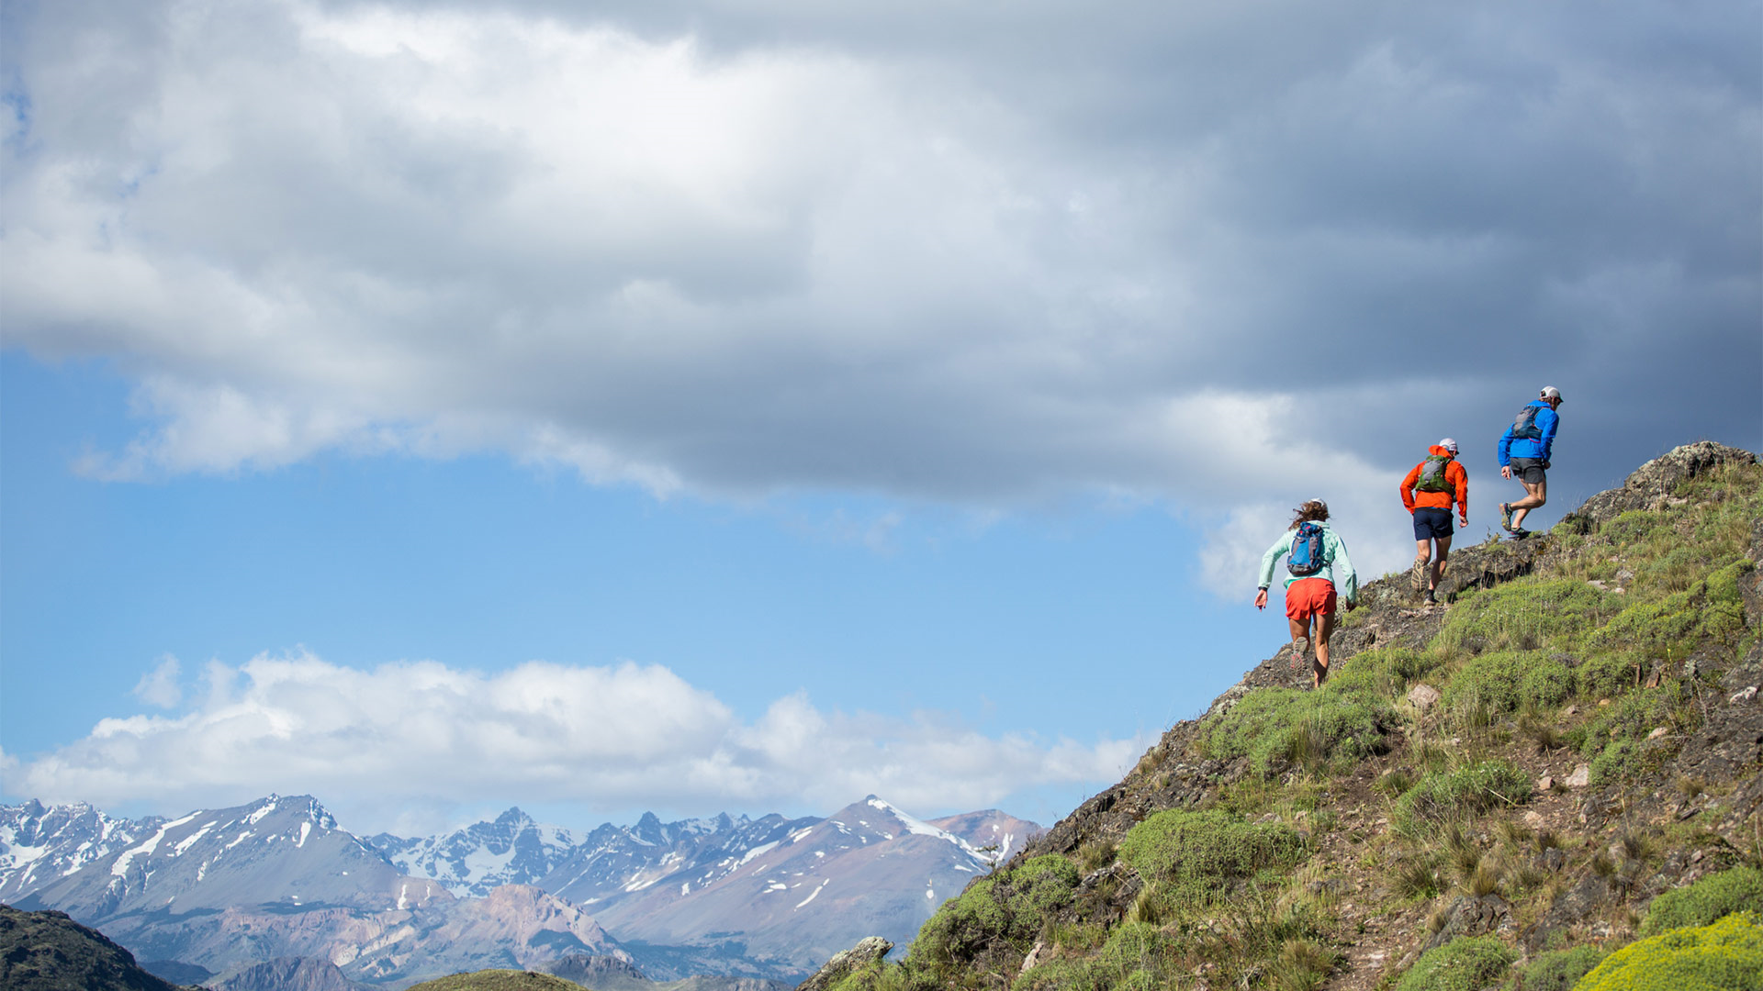
Modelling Approach Tree…
Pace
Predictor
1. Predict pace from my pacing in previous races.
2. Predict pace from my placing in previous races.
1a.
Let Random Forrest Regressor decide what is important.
1b.
Decide what is important and use linear regression (lasso).
2a.
Use my average placing and predict based on SCC athletes in that place.
2b.
Predict a better average place by determining the effects of course and fitness on my placing.

Slide 8
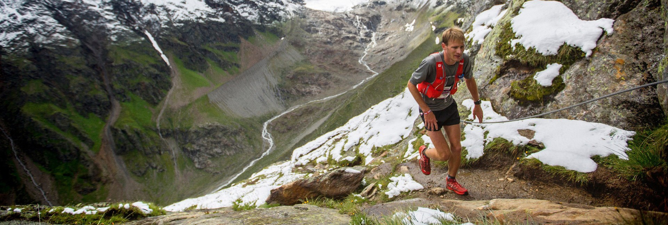
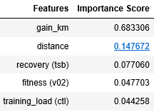
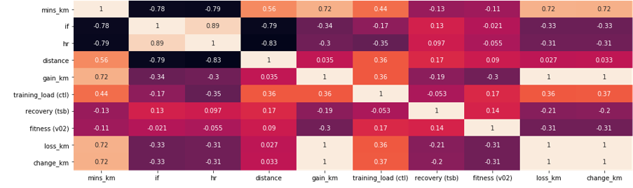

Predict pace from my pacing data…
1a. Let Random Forrest Regressor decide what is important.
1b. Decide what is important and use linear regression (lasso).
ID variables with a strong relationship to mins/km
ID which variables they are also related to and choose 1.

Slide 9
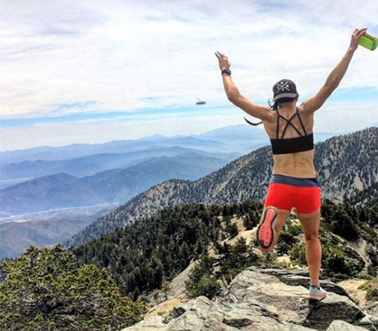
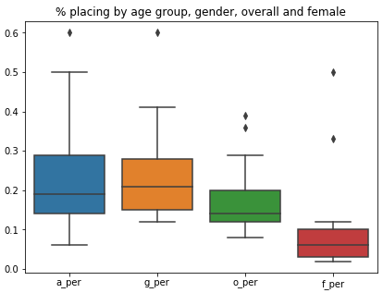
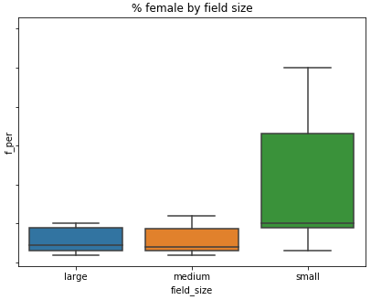
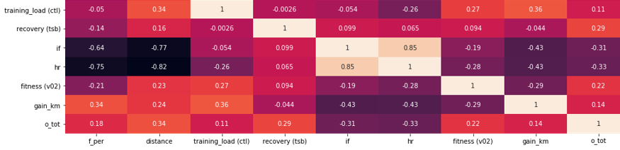
Predict Pace from my Placing Data…
2a. Use my average placing
% Female placing in Med/large fields
Fitness, effort and terrain data to explain remaining variation
2b. Predict a better average place
determining the effects of course and fitness on my placing.

Slide 10
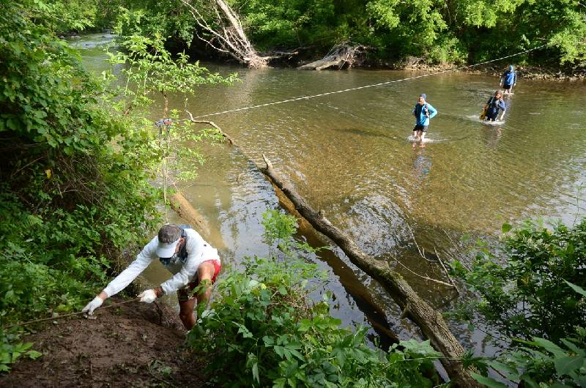
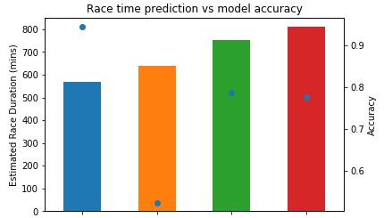
Results…
Model Success Metrics
Maximise R2 (relationship) and Minimise MSE (Prediction Error)
Have low variation in MSE during cross validation (accuracy on new data)
Strength of Relationship | H | 1A.
 | M | 1B. | 2B.
 | L | 2A.
 |  | L | M | H
 |  | Accuracy on New Data
9:30
10:37
12:33
13:29
1a. Own
Metrics
(rf)
2a. Top 6%
Female
(ave result)
2b. Top 18%
Female
(ridge)
1b. Own
Metrics
(lasso)

Slide 11
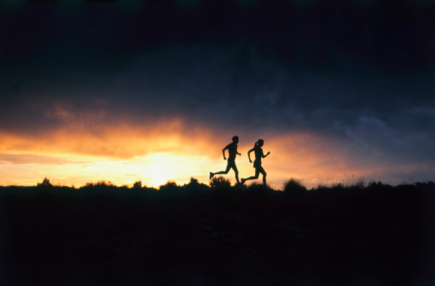
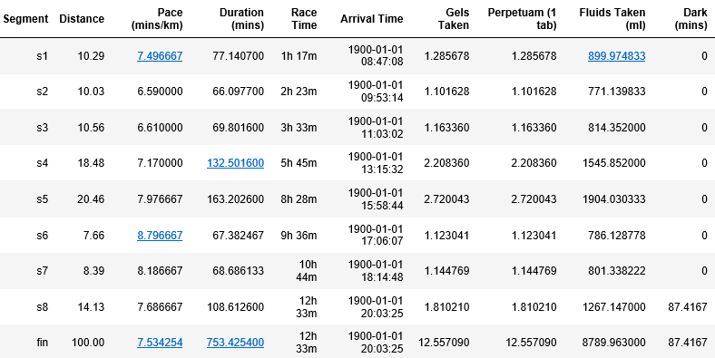
The Race Plan…
SCC will take me 12.5hrs, ranging between 6:30 – 8:45 per km.
Over the 100km, I will consume 13 gels, 13 tabs and 8.7 litres.
I will see my family at 1:15pm (50km) and 8pm (100km)
I will need my headlamp for the last segment (87 minutes).

Slide 12
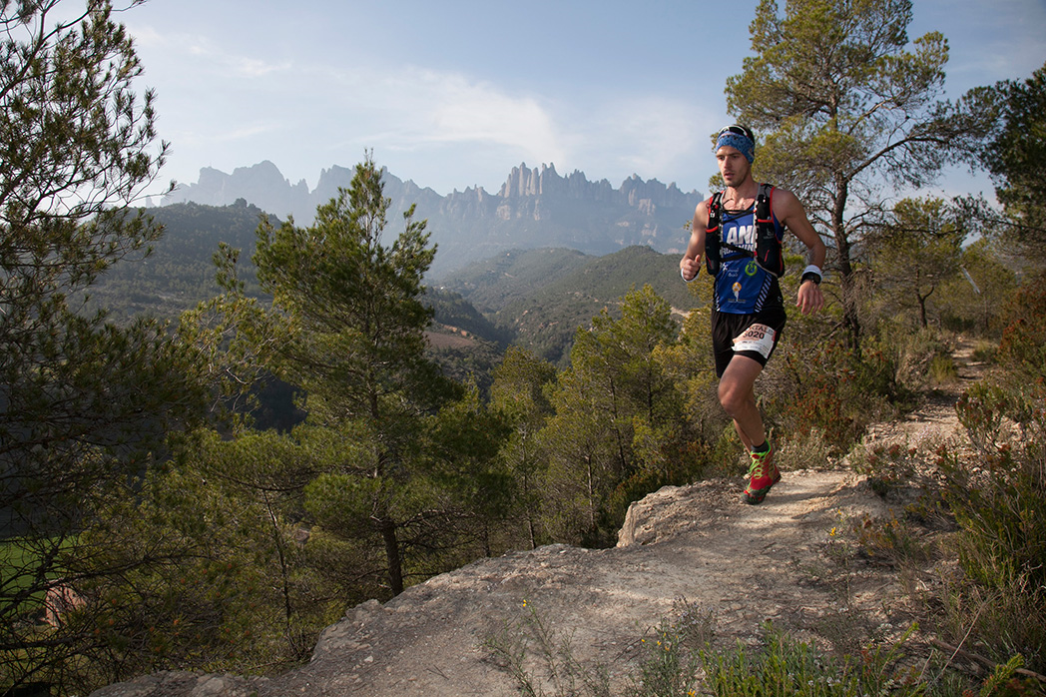
Next Steps…
Confidence Levels: Create a range of paces/times
Increase Sample Size: Introduce training data
Environmental Data: Wind, altitude, temp and humidity.
Course Elevation: Per 10m rather than 10km
Course Terrain: Sand, Stairs, River, Road, Trail
Equipment: trekking poles, change of shoes, clothes

Slide 13
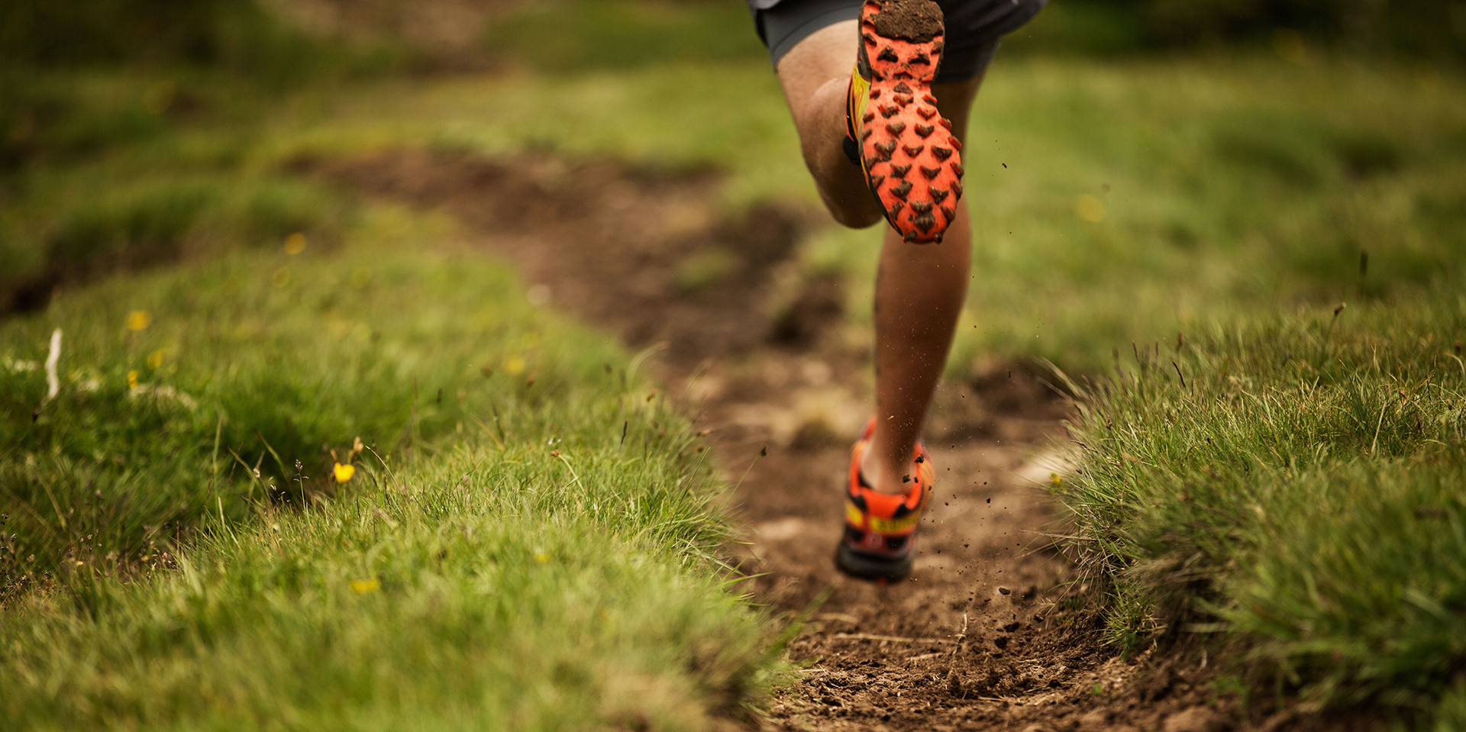
Thank You

